Slide 1
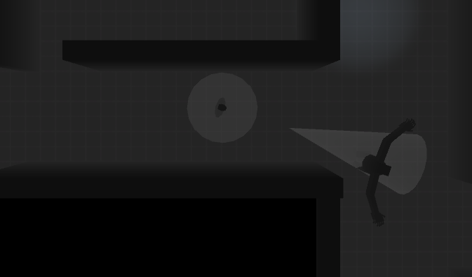
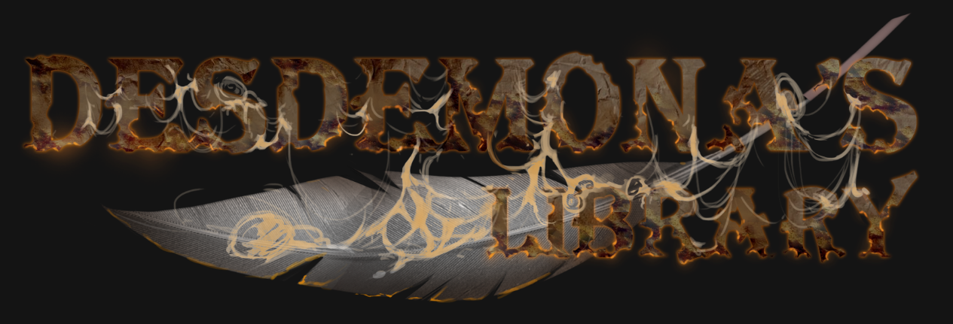

Slide 2
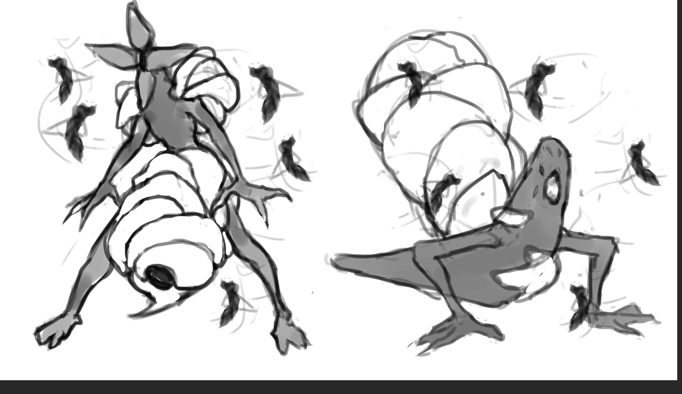

Desdemona’s Library USPs
Top Down point and click horror
Player can only run and hide
Player can lose control of character
Set in Portland library in 1980s
Notes:
Top down point and click horror game
Player can only run and hide
Must make sure they control their fear, otherwise they will lose control
Set in library in Portland, 1980s

Slide 3
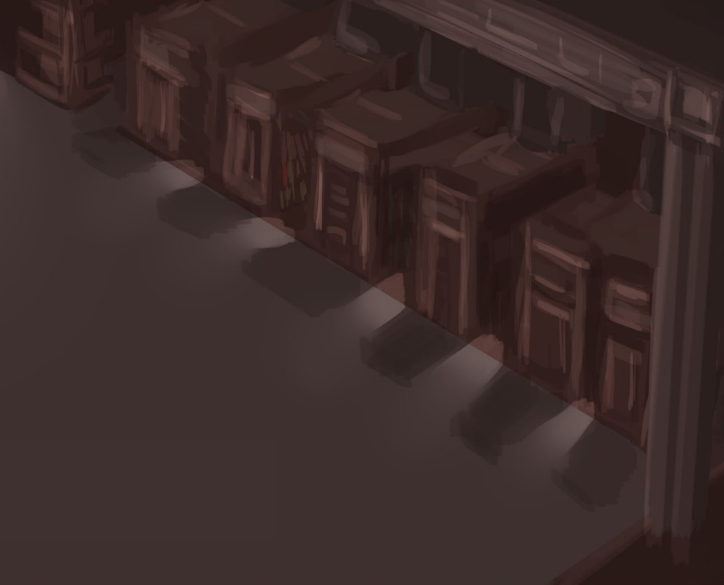
Story Concept
You are a Librarian.
A break-in occurs and you are knocked out.
It is a cultist who has broken in and commits suicide in order to complete the ritual.
You then try and find the book in order to stop the creature.
Finding the book you need to find certain item to stop the creature.
Failing this, your only option is to escape.
Notes:
You’re working late night at the library
You hear a disturbance and upon investigating you’re knocked out
You come to and are tied to a chair as you witness a cultist sacrifice himself to summon a demon from another realm
You must find out how to reverse the ritual and avoid the creature at the same time

Slide 4
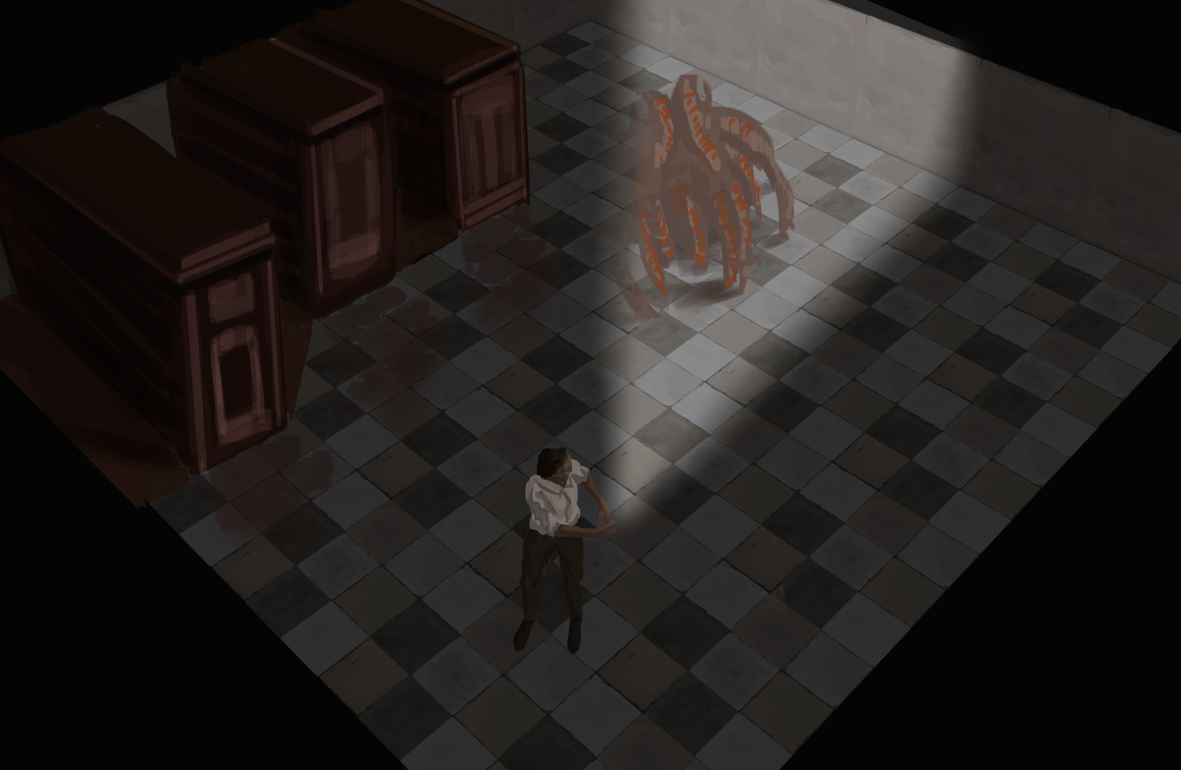
Game Mechanics
Restricted view
Certain objects hidden from view
Players fear affects level of control
Sound ripples generated throughout level
Fog of war
Undiscovered rooms are blacked out
Parasite enemies alert monster
Notes:
Top down view and cone of vision restrict view
Certain objects and enemies will only be revealed when in cone of view
Fear bar shows player how coherent their character is, which affects how much control they have
Noises throughout level will create sound ripples that are visible to the player to show where the enemy possibly could be
Levels have fog of war and some rooms will be blacked out until the player enters them, this causes stress and tension
Smaller parasite-like monsters can latch on to you and alert the main monster to tell them your location. You must rip off the parasite and relocate before the monster finds you.

Slide 5
Gameplay Loop
Enter
You enter, looking to find an object
Hide
Realising the monster is here, you hide into the environment to get around.
Run
Once collecting the item, you hide and run in order to escape the room.
Notes:
The player is exploring, he sees a blacked out room so enters to reveal it. You see the object you need to collect, however the monster is also waiting. It spots you and begins to chase, so you backtrack and find a cupboard to hide in. Waiting patiently, the monster then begins to scour other rooms to find you. You must quickly enter the room, grab the item and escape before he finds you.

Slide 6
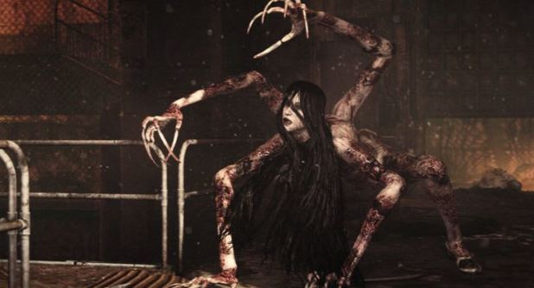
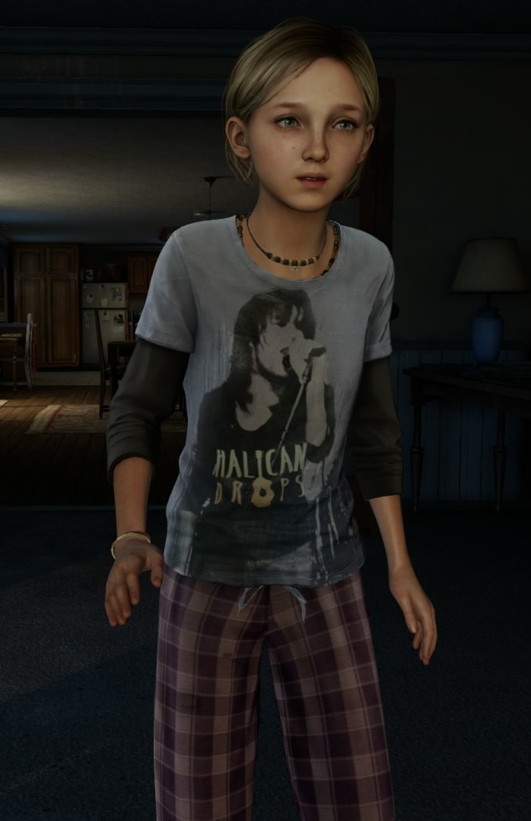
Animation Inspiration
Enemy
- Creepy.
Fast, Jittery and unpredictable.
Unnatural.
Player
Scared, frightened and in a panic.
Worried about everything.
Loss of sanity will change how they move and act.
Notes:
The enemy animations take inspiration from games such as The Evil Within. The monster will be very jittery and unnatural. This will cause tension and scare the player.
The player animations will focus on making the character seem scared and in a panic. Depending on their sanity, they will act erratically and refuse to move.

Slide 7
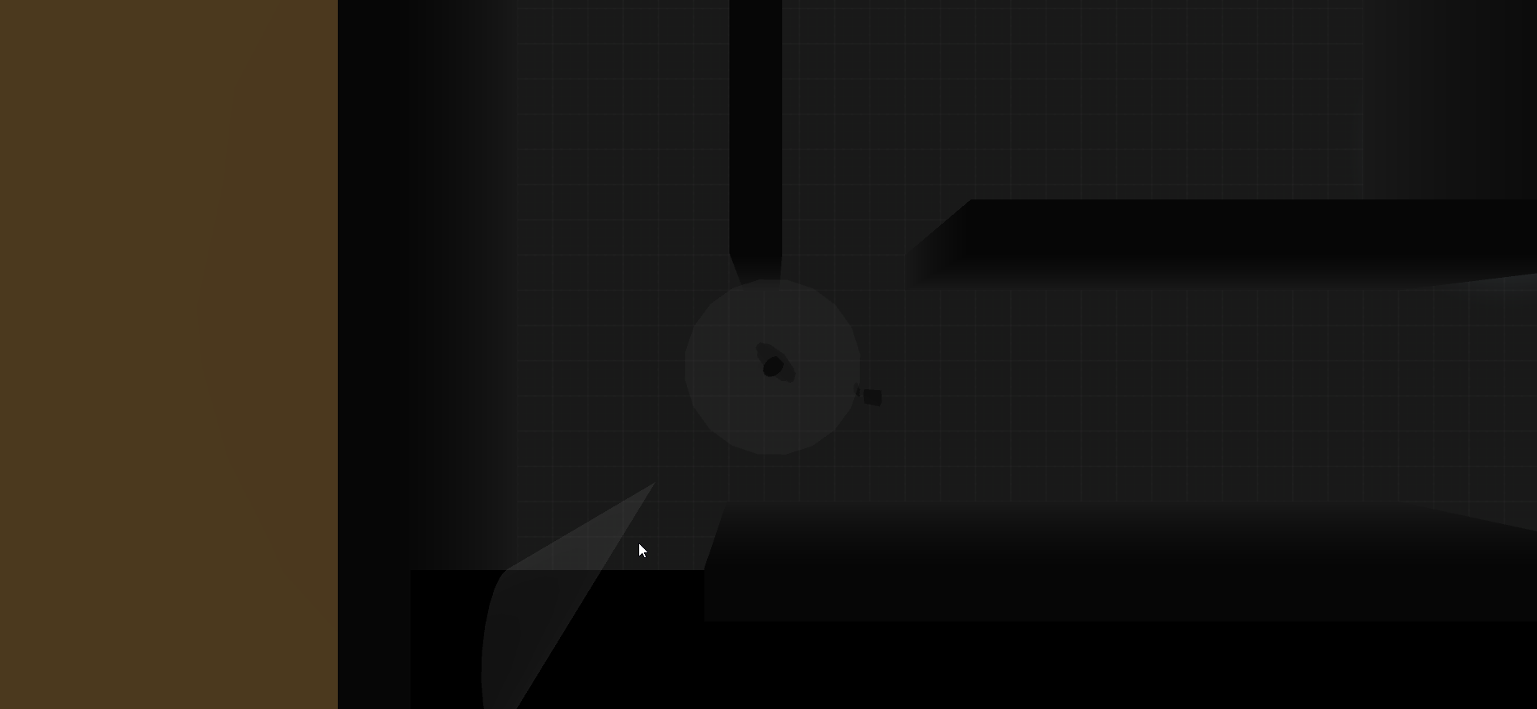
Example Mechanics
Right: Being chased by the monster
Left: Using cone of view to reveal objects

Slide 8
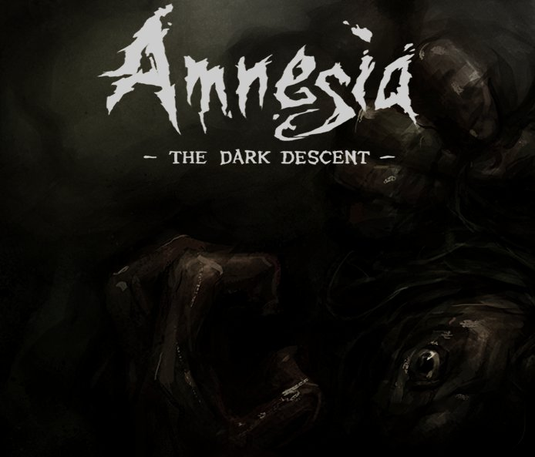
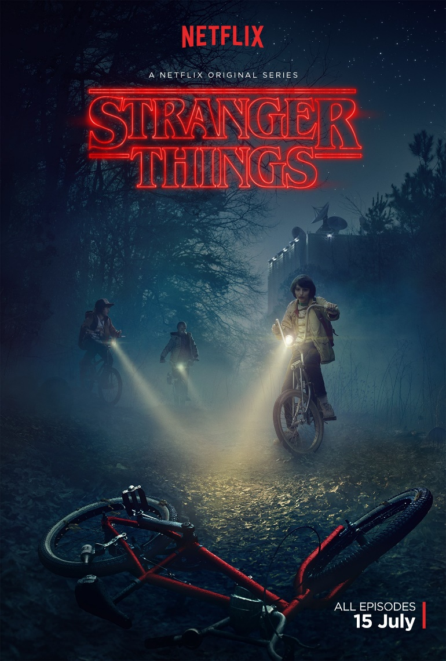
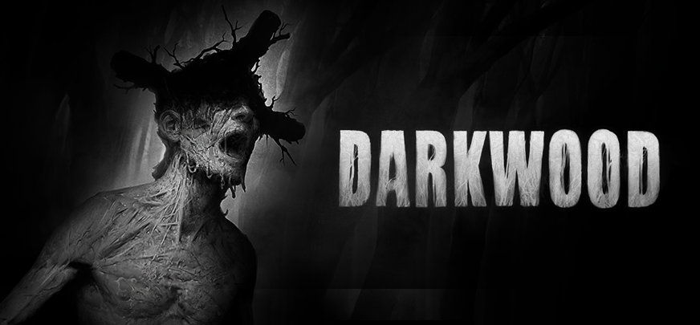
Inspiration
Darkwood (2017)
Amnesia (2010)
Stranger Things (2016)

Slide 9
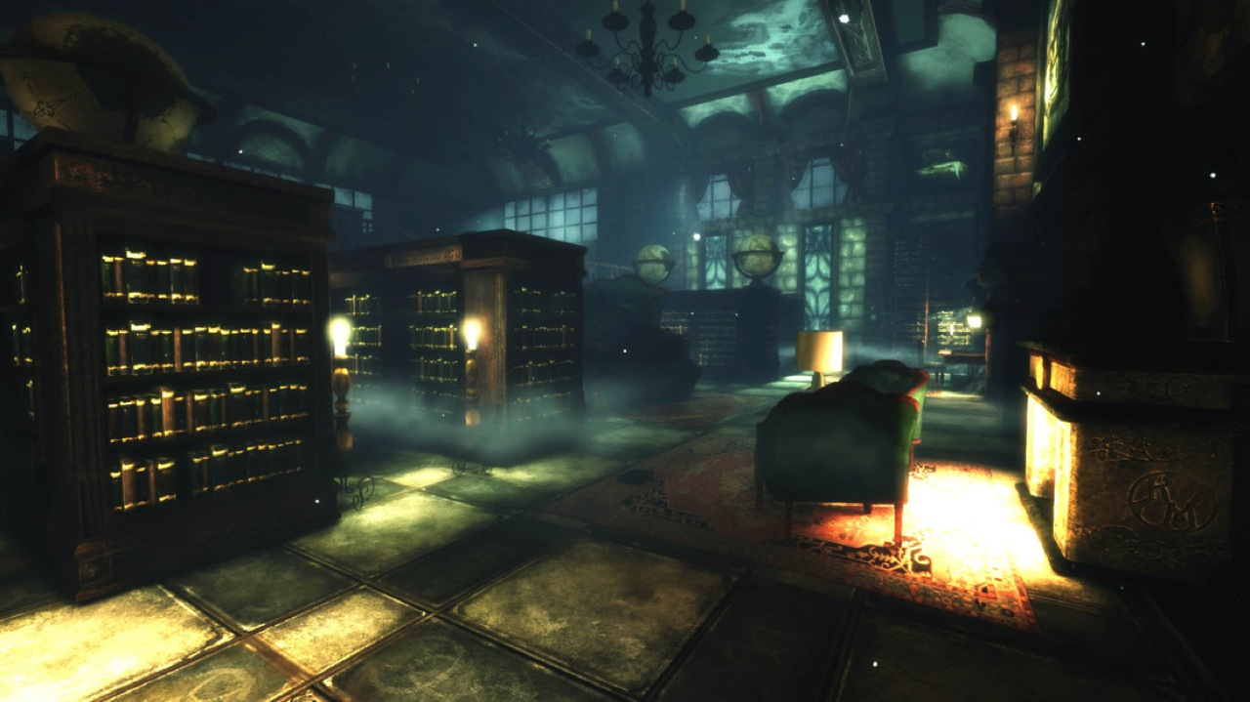
Aesthetics and Audio
Lovecraft mixed with 80s
Dark visuals with eerie details
Audio is haunting and minimal most times
Dark ambiance will be eerie with little music
Synth-bass style music

Slide 10
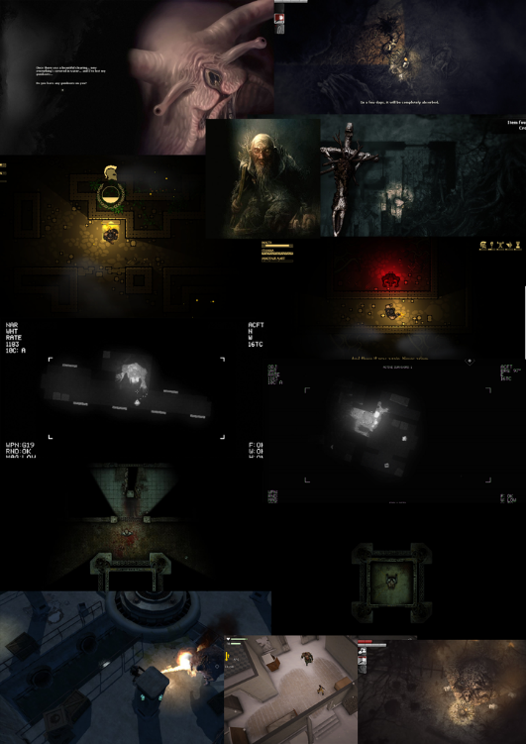
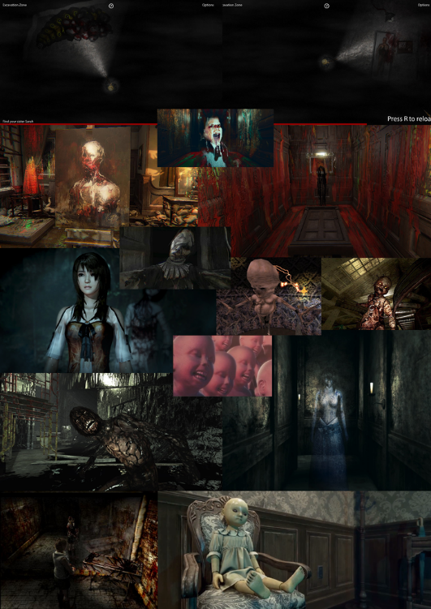
Moodboards

Slide 11
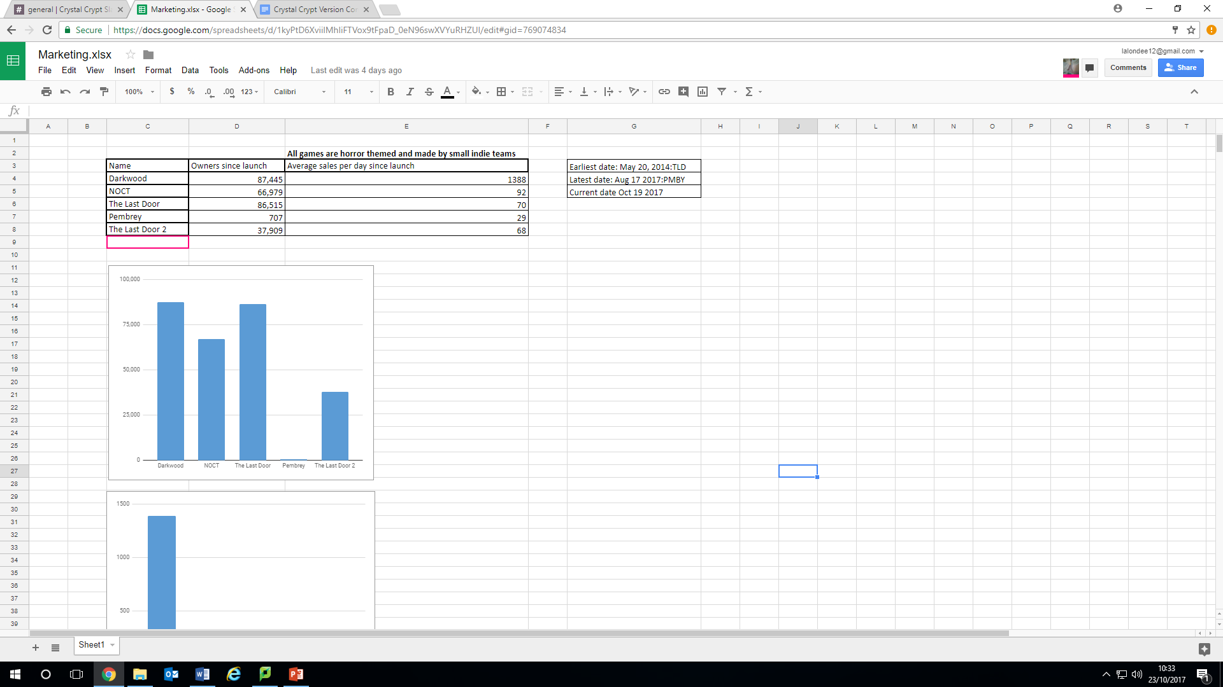
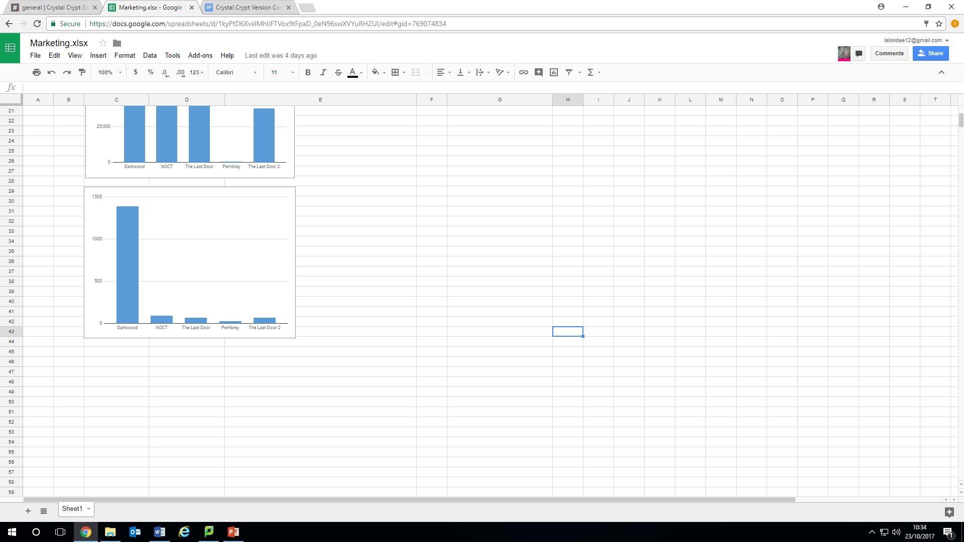
Market Research
Number of owners since launch
We looked at five different games which we concluded were similar to ours, based from these aspects.
Top Down.
Point and click.
Horror.
Created by an indie studio.
From this we investigated the number of owners they've had since launch, and the average sales per day.
Earliest date: May 20, 2014: The Last Door
Latest date: Aug 17 2017: Pembrey
Price….
Average sales per day since launch

Slide 12
Thank You For Listening!
Any Questions?

Slide 13
References
Slide 2 Library - Liden & Denz. 2017. 4 Amazing Libraries in Moscow - Liden & Denz. [ONLINE] Available at: https://lidenz.ru/libraries-in-moscow/. [Accessed 23 October 2017].
Slide 2 monster - Pinterest. 2017. illustrations of hp lovecraft monsters - Google Search | Daikaiju | Pinterest | Hp lovecraft, Illustrations and Cthulhu. [ONLINE] Available at: https://www.pinterest.com/pin/519884350715640157/. [Accessed 23 October 2017].
Game Informer. 2017. Taken To Horror School With Kraven Manor - Features - www.GameInformer.com . [ONLINE] Available at: http://www.gameinformer.com/b/features/archive/2014/05/01/taken-to-horror-school-a-look-a-kraven-manor.aspx?SortOrder=desc. [Accessed 23 October 2017].

